Slide 1
Preschool Multi Tiered System of Supports Initiatives
MAISA Annual Conference
June 20, 2012
Notes:
Corrie

Slide 2
Introductions
Corrie Mervyn
Early Childhood Coordinator
Ingham Intermediate School District
Tami Mannes
Early Childhood Coordinator
Ottawa Area Intermediate School District
Notes:
ALL

Slide 3
Overview Of The Session
Key Features of a Multi Tiered System of Supports (MTSS)/Response to Intervention (RtI) Framework
Importance of Early Intervention and Preschool-3rd grade Learning Continuum
Two examples of ISDs engaging in this work in Michigan
Notes:
Corrie

Slide 4
Key Features Of MTSS/RtI
Research-based instruction, strategies and interventions
Universal screening
Data-based decision-making
Problem-solving
Progress monitoring
Shared leadership
Family and community involvement
Notes:
Corrie
RtI is the practice of …
… providing high-quality instruction/intervention matched to student needs and
… using learning rate over time and level of performance to
…make important educational decisions.
(Batsche, et al., 2005)

Slide 5
Why Preschool?
“A compelling body of evidence affirms that early intervention is key to children’s success representing best practice in early child development and education. Thus, to place children on a trajectory for success, RtI is best-positioned to begin at the pre-k level.”
Coleman, Roth, & West, (2009), pg. 6
Notes:
Corrie
Early intervention support can prevent or mitigate
the occurrence of language, literacy, and academic
learning difficulties.

Slide 6
Why Preschool?
MTSS/RtI provides a framework for assessment and services
Early intervention to potentially remediate learning gaps prior to Kindergarten entry
Increase collaboration between various stakeholders throughout the early childhood community
Intensive and systematic interventions are essential for students who are at-risk
Intervention should be multiple years to obtain the greatest benefit
Dion, Brodeur, Gosselin, Campeau, & Fuchs (2010); Jackson, Pretti-Frontczak, Harjusola-Webb, Grisham-Brown, Romani (2009)
Notes:
Corrie

Slide 7
What We Know:
“A comprehensive preschool-through-third-grade (P-3) approach is needed to ensure that
children develop a solid foundation in literacy, math, social-emotional skills, as well as strong
engagement in learning. When schools link pre-k education with the elementary grades, the
gains that children make in high-quality pre-k are more likely to persist.”
Shore (2009), p. 6
Notes:
Corrie

Slide 8
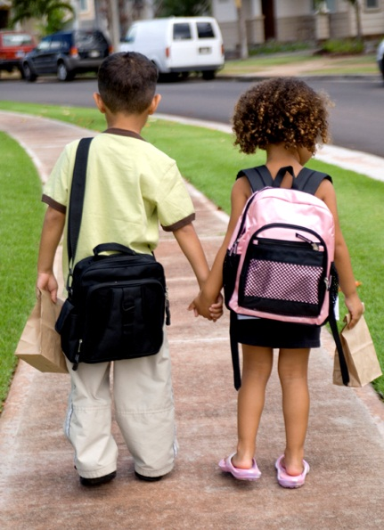
Pre-kindergarteners who attend programs that are aligned with the educational goals of early elementary schools:
Are more prepared to start Kindergarten
Have better developed cognitive, academic, social and emotional skills
Are more likely to graduate high school and be productive citizens
Are less likely to have children in their teen years or become entangled in the criminal justice system
Decrease in special education identification
Foundation for Child Development, 2005
Notes:
Corrie

Slide 9
Current Research On Preschool Literacy
Early literacy skills impact long-term success (Hamre et al., 2010; Justice et al, 2009)
Quality of preschool language and literacy instruction is low (Hamre et al., 2010; Justice et al, 2009)
Within a preschool setting literacy instruction occurs only 5-8% of the time (Carta et al., 2010)
Translating to 25-minutes within a 3-hour time block
Notes:
Tami

Slide 10
Current Research On Preschool Literacy
We know which precursor and early literacy skills lead to increased conventional literacy skills in the early grades
We know we can impact important early skills using different programs and different settings
We know that there are many things parents and preschools can do to improve literacy development
We need to ACT on this knowledge!
Notes:
Tami

Slide 11
Current Research On Preschool Behavior
Preschool programs positively impact student behavior, especially those at risk of academic failure
Children who display externalize behaviors tend to exhibit lower motivation and less positive attitude toward school
Initial feelings towards school environments persist into later school years.
Dominguez, Vitiello, Maier, Greenfield, 2010.
Notes:
Tami

Slide 12
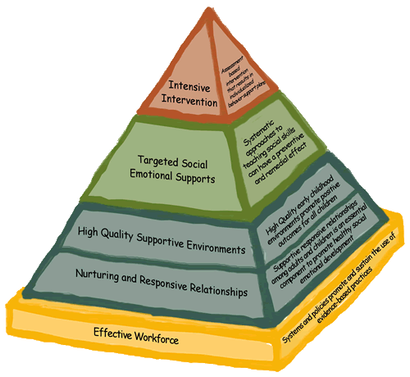
Key Components of Positive Behavioral Interventions and Support
PBIS for Young Children is a framework for program-wide, classroom-wide systems that prevent preschool aged children from developing problem behavior through:
Building positive relationships among children and adults
Purposeful arrangement of classroom environments
Designing age-appropriate schedules and routines, and
Explicit teaching of skills and behaviors
Notes:
Tami

Slide 13
Ingham ISD
EARLY YEARS RESPONSE TO INTERVENTION INITIATIVE
Notes:
Corrie through all of Ingham’s stuff

Slide 14
Early Years RtI Goals and Strategies
Increase alignment and continuity between early learning settings and elementary school
Improve assessment practices
Increase school readiness and supported transitions to kindergarten for all students
Improve quality in early childhood settings
Align curriculum standards, assessment and instructional practices using the MTSS/RtI framework
Increase use of evidence-based interventions to support literacy and social-emotional development
Facilitate successful movement for children and families from early childhood to kindergarten
Equip families to support their child’s development (both academic and social-emotional)
Notes:
Our Early Years RtI goals and Strategies are to increase the alignment from the preschool classroom to the elementary school classroom and to increase school readiness and supported transitions to kindergarten for all students

Slide 15
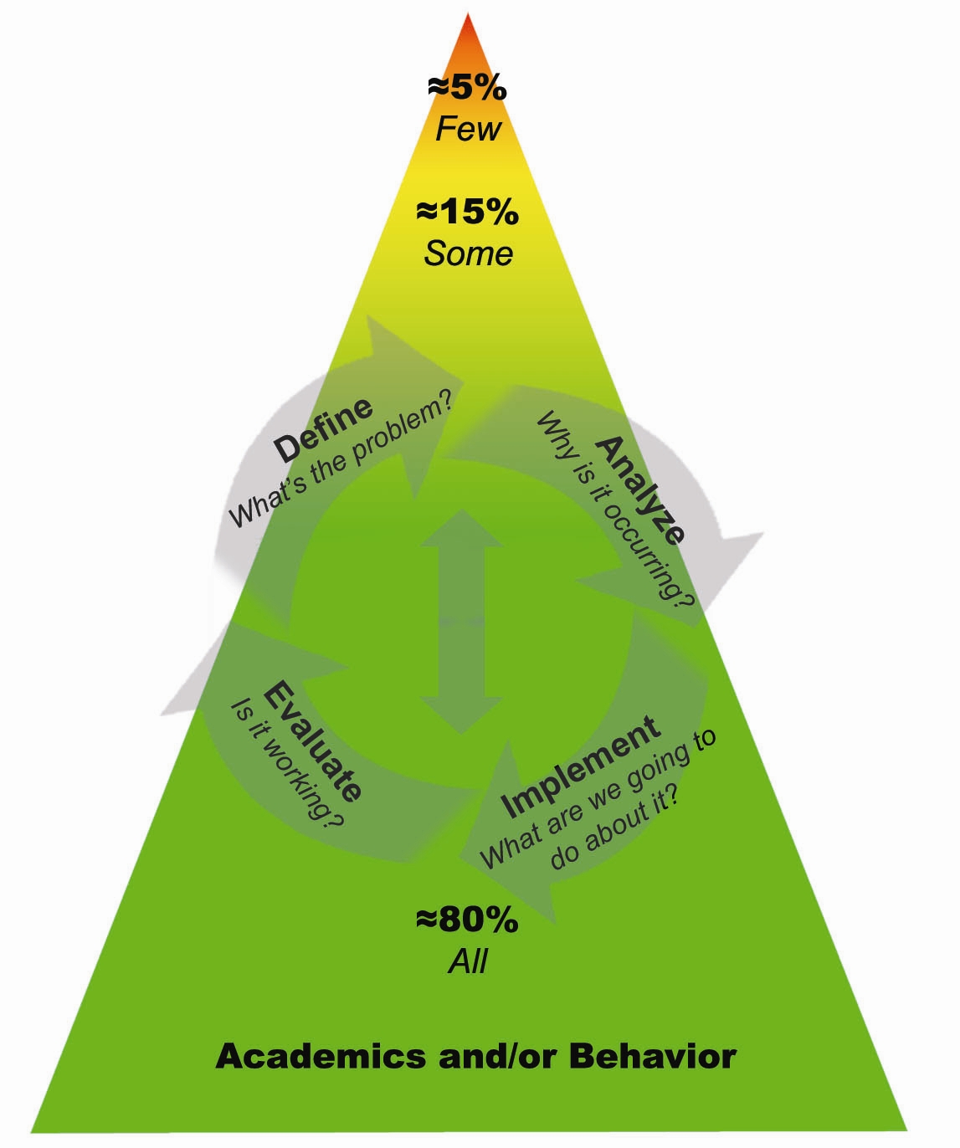
Ingham Early Years RtI Model
ACADEMIC / LEARNING SYSTEMS
Tier 3: Comprehensive & Intensive
Students who need individualized interventions
Individualized scaffolding strategies
More frequent progress monitoring
Tier 2: Strategic Interventions
Students who need more support in addition to the core curriculum
Explicit small group interventions and embedded learning activities
Progress monitoring
Tier 1: Core Curriculum
All students
Researched based
Intentional teaching
Universal screening
BEHAVIOR SYSTEMS
Tier 3: Intensive Interventions
Students who need individualized intervention
Behavior support plans
Tier 2: Targeted Group Interventions
Students who need more support in addition to universal interventions
Targeted social emotional supports
Tier 1: Universal Interventions
All students in all settings
Nurturing and responsive relationships
High quality supportive environments
Our model adapted from IISD K-12, Recognition and Response and The Center on the Social and Emotional Foundations for Early Learning
Notes:
RtI is the practice of providing high quality instruction/intervention within a muti-tiered system of support matched to learner needs. We use data based decision making and problem solving to monitor and adjust instruction and interventions for young children ongoing.
This model is adapted to support the emerging national research in early childhood RtI practices and is aligned with our K-12 RtI model to facilitate a seamless transition for children, families and educators between early childhood and K-2 systems.

Slide 16
How We Began
2010-2011- Ingham ISD received an Early Years ReImagine grant from the Early Childhood Investment Corporation
Partnered with the University of North Carolina-Frank Porter Graham Child Development Center to conceptualize an Early Childhood RtI model
Partnered with Capital Area Community Services Head Start who were awarded a Mentor Coaching Grant to employ early childhood coaches to provide job-embedded support for implementation of RtI practices in the classroom
Ran a pilot with 20 preschool classrooms including representation from Head Start, Great Start Readiness Program, Tuition, Montessori, and Early Childhood Special Education

Slide 17
2010-11 Training
Training was focused on changing adult practice to better meet the needs of students
100% of preschool classrooms used a universal screener for early literacy with children with implementation fidelity of 74%
93% of preschool classrooms implemented research based early literacy strategies with whole group and small group instruction
96% of the improvement goals identified for all preschool classrooms were in progress or achieved to increase the quality of each classroom environment around adult-child interactions and early literacy
Notes:
Coaches and preschool teachers completed surveys and fidelity checklists around key practices to identify these accomplishments and changed practices as a result of the trainings and classroom coaching support provided.

Slide 18
2011-12 Pilot Expansion
Ingham ISD supported the expansion of the project using general funds along with the remainder of the Mentor/Coaching grant from CACS Head Start
A second cohort of 20 preschool classrooms were added in a voluntary process
Engaged both cohorts in PBIS work
Expanded the emergent literacy work with Cohort 1
Training focused on use of instructional strategies and assessment data to improve student outcomes

Slide 19
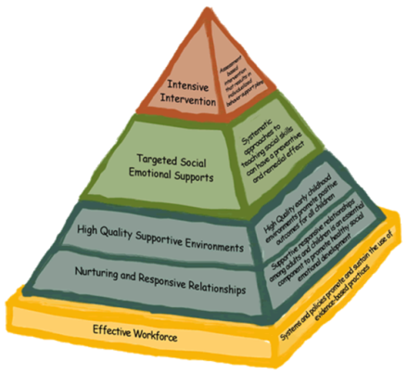
PBIS Implementation
Engaged classrooms in the Center on the Social and Emotional Foundations for Early Learning
(CSEFEL) Pyramid Model focusing on Tier 1
practices-High Quality Supportive
Environments and Nurturing and
Responsive Relationships
Used CSEFEL’s Inventory of Practices Self Assessment Survey and a created PBIS Walk-through tool to support Implementation Fidelity

Slide 20
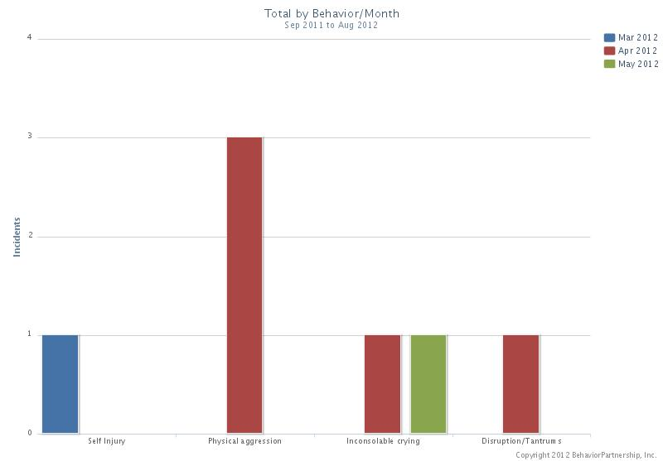
Continuing PBIS Implementation Work In 2012-2013
Measure implementation fidelity of program wide PBIS using the Program Wide Evaluation Tool, PreSET
Record student behavior incident reports using the Behavior Incident Recording System (BIRS)
Guide teachers in interpreting and analyzing BIRS data to provide students with targeted and intensive social emotional interventions
Notes:
Make note of new researched products available

Slide 21
Emergent Literacy Instruction Implementation
Trained teachers in the administration of The Preschool Early Literacy Inventory (PELI) universal screening tool, authored by Dynamic Measurement Group (DMG)
Equipped leadership teams to ensure fidelity of the administration of the PELI using a Reliability Checklist, created by DMG
Led teachers in analyzing PELI student data to inform instruction and intervention using research based strategies in the areas of emergent literacy

Slide 22
Continuing Emergent Literacy Instruction Implementation Work In 2012-2013
Continue working with Cohort 1 classrooms and engage Cohort 2 classrooms in emergent literacy work including:
Universal screening using the PELI
Data driven intentional teaching methods that include embedded and explicit instruction and intervention

Slide 23
Ottawa Area ISD
Preschool Response to Intervention Initiative
Notes:
Tami through all of Ottawa’s stuff

Slide 24
Goals
Explore national dialogue on best practices of RtI
Increase educator knowledge, understanding, and application of promising practices in RtI at the preschool level
Implement select components of an RtI model in the areas of behavior and literacy
Share ideas and knowledge with other members of the project

Slide 25
Local Participation
Application process
Any district within the county could apply to participate in the pilot project
Must be engaging in RtI practices K-5
Must send a team to trainings
Mandatory Representatives: (Special education, Great Start Readiness Preschool, Tuition-based preschool, Young Five’s, Administrator)
Head Start also had a team
If selected as part of the pilot
Teams must attend all trainings
Given a stipend to help offset costs ($1000)
5 districts were accepted into the project

Slide 26
Training Provided
Winter 2010
Overview of RtI
Winter 2010
Positive Behavior Interventions and Supports for Young Children
Jason Novetsky, Ph.D
Spring 2010
Finalize plans for rolling out PBIS in the fall
Summer 2010
Review plan for PBIS implementation
Begin planning for literacy implementation
Fall 2010
Trained in Literacy Screeners: Preschool Early Literacy Indicators (PELI) and Get It! Got It! Go!
Winter 2011
Wrap up meeting to plan for next steps
Focus day on literacy strategies
Focus day on Tier 2 and Tier 3 behavior strategies/interventions
Fall 2011
Goal Setting / Implementation Plan

Slide 27
PBIS: Tier One
Results from the Positive Behavior Support for Early Childhood Classrooms—Assessment and Planning Tool (completed in April)
Variability in overall percent of items in place (30-85%)
Programs are universally doing a good job of setting up the learning environment (schedule and physical layout) in a predictable and well organized fashion
Providing at-risk and individualized behavior support are the greatest areas of need

Slide 30
Essential Components Of Literacy Assessments-Our Rubric
Definition of Terms –
Screening: Use of a brief procedure or instrument designed to identify those who need further assessment or support.
Progress Monitoring: Determines through frequent measurement if students are making adequate progress or need more intervention.
Diagnostic Assessment: Helps to plan instruction with in-depth information about student skills.
Outcome Assessment: Comprehensive evaluation of program effectiveness/skill acquisition in relation to benchmarks/goals.
Highlighted Tools: PALS (Phonological Awareness Literacy Screen) ELSA (Early Literacy Skills Assessment) Get It, Got It, Go (IGDI) PELI (Pre-School Early Literacy Inventory) | Does Tool Measure Relevant Skills? (NELP Findings) Strong Indicators of Early Literacy Skills -Alphabet Knowledge -Phonological Awareness -Rapid Automatic Naming – Letters/Digits -Writing/Writing Name -Phonological Memory -Oral Language (Definitional Vocabulary; Listening Comprehension; Grammar) Moderate Indicators of Early Literacy Skills -Concepts About Print -Print Knowledge -Visual Processing -Oral Language (Expressive/Receptive Vocab.)
Is Tool User Friendly? -Time to administer -Ease of administration -Cost | Are Technical Characteristics Adequate? -Reliable, valid, accurate -Sensitive to individual skill growth/adequate progress -Designed for multiple administrations each year
Is Understanding and Use of Data Evident? -Ease of obtaining and interpreting results -Cut-off scores available -Planning for instruction is evident from results -Data may be entered on-line/report options | Is Tool Culturally Sensitive? -Language formats -Content -Normative scores with diverse populations
Is Tool Compatible with Adopted Curriculum? -Skills measured are congruent/correlated | Are Parents Included As Partners? -Parent friendly information exchange and support -Parent input is sought and incorporated

Slide 31
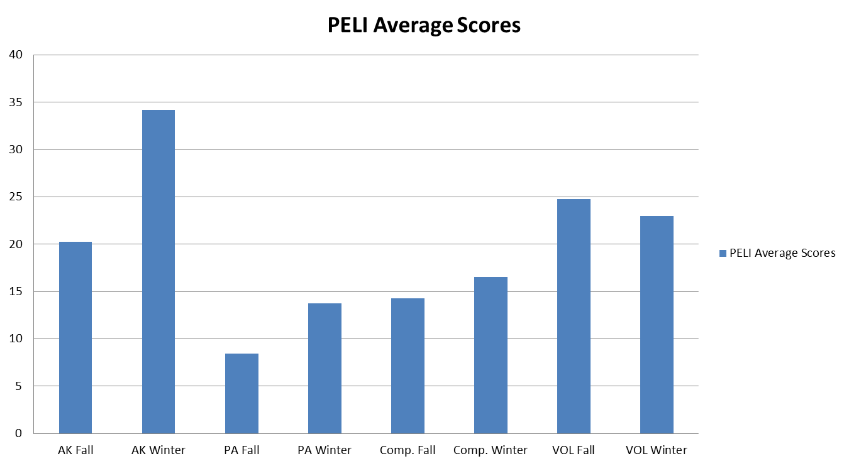
Data

Slide 32
Next Steps
Continued professional development for all tiers in both literacy and behavior
Ensuring accountability to parents
The need for on-going coaching to ensure the implementation fidelity
Discussing potential to bring on another group of schools
Struggling with time and resources that we currently have

Slide 33
SUCCESSES and CHALLENGES

Slide 34
Successes
Use of positive approach with ALL students
Teachers planning literacy instruction based on student data
Increased dialogue between programs (Head Start, Great Start Readiness Program, Early Childhood Special Education, etc.)
Time to collaborate between multiple programs from different districts
Awareness of the importance of differentiated instruction at Pre-School for at-risk children
Increased collaboration with elementary staff and administration
Notes:
Corrie

Slide 35
Challenges
Braiding and integrating various funding streams and program requirements (Head Start, Great Start Readiness Program, Early Childhood Special Education)
Most preschool programs are set up to serve the at-risk population
Resource sustainability
Disparate supervision and locations of early childhood classrooms makes it difficult to provide coaching and mentoring support
Differences in early childhood teacher preparation
Debate of developmentally appropriate practices
Limited research of tier one research-based instructional practices
Limited research surrounding tier two and three instruction and intervention
Notes:
Tami

Slide 36
How To Contact Us:
Corrie Mervyn
cmervyn@inghamisd.org
Tami Mannes
tmannes@oaisd.org
Notes:
Tami

Slide 37
Resources

